Slide 1
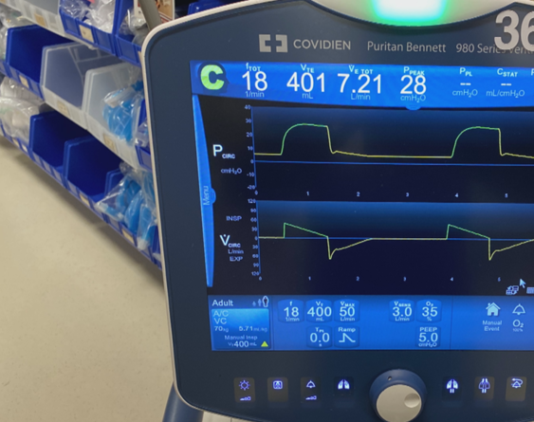
Ventilator Troubleshooting
Brian Locke, MD
Pulmonary / Critical Care Fellow
University of Utah

Slide 2
Overview:
You will be faced with one of two problems:
“The ventilator is alarming”
“The patient looks uncomfortable” (or, conversely, I gave sedatives to keep them comfortable).
Physiology review: why does this happen?
Schemas for how to address ventilator alarms and patient dyssynchrony

Slide 3
A warmup riddle:
ABG is 7.15 / 75 / 50 on FiO2 1.0 and PEEP 14, RR 30, Vt 6 ml/Kg
What will stop you from going up on each of these indefinitely?
Oxygenation = obviously can’t go above pure oxygen.
What would happen if you kept going up on PEEP? When would you stop?
What would happen if you kept going fast on RR?
What would happen if you kept going up on the Vt?

Slide 4
Part 1: ”The Ventilator is Alarming”
What is the alarm?
Circuit disconnect, Breath not Delivered
Inspect circuit for break or kink
Minute ventilation low?
Are you on pressure support? Put on assist control-mode
Are you in ACPC? This is the equivalent of high pressures
Minute ventilation high?
Is this rapid shallow breathing? Go to patient looks uncomfortable
Large Tidal Volume?
Is this breath stacking? Discuss in 2nd part
Most common: High peak pressures pressures

Slide 5
Why is this so hard? 2 conflicting principles of ventilator management
Lung Protective Ventilation: ARMA, 2000
Sedate deeply, unnaturally small breaths to protect lung
Notes:
Baby lung = the injured lung is nonfunctional, breaths are going to a small remaining part of the lung.
Spectrum from deeply sedated, very protective breathing to very awake, breathing how our brainstem wants = injurious

Slide 6
Notes:
Tobin
N Engl J Med 2001; 344:1986-1996 DOI: 10.1056/NEJM200106283442606

Slide 7
Why is this so hard? 2 conflicting EBM principles of critical care
Daily sedation vacation
Restart at ½ dose; avoid accumulation
Less sedation accumulation, faster weaning and extubation
Notes:
ABC / Wake up and breath paired this with SBT -> probable mortality benefit (Lancet, Giroud)
These are in conflict: deeper sedation allows safer ventilation, but light sedation shortens time on the vent and also helps mortality

Slide 8
Why is this so hard? 2 conflicting EBM principles of critical care
Ventilator Alarms = how to ensure Lung Protective Vent occurring
Patient synchrony = how to do Lung Protective Vent with least sedation
Lung Protective Vent
Brainstem desired Vent
Ideal
Ideal
Deeply Sedated
Lightly Sedated
Priorities shift:
Early in course: most inflamed lungs. Prioritize left
Later in course: weaning crucial. Prioritize right
Notes:
Thus, the goal of part 1: how can we make sure our ventilation is afe?
The goal of part 2: how can we have the sedation as light as possible but still allow safe ventilation.
Priorities shift throughout duration of illness: sometimes you have to sacrifice one for the other.
First day = most important to safely ventilate (most inflamed lungs), first week more important than next. Etc.
As they get closer to extubation, more awake is more important. Thus, balance my shift from day to tday.

Slide 9
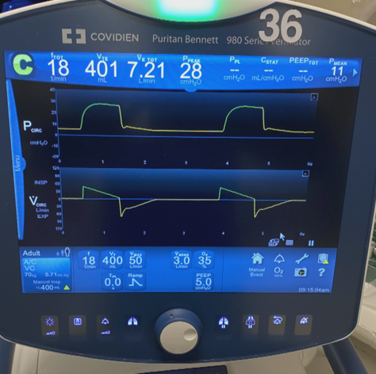
Assisted vs Control Breath
What the patient is getting
Alarm shows up here (Yellow or Red, based on urgency)
Ventilator Mode Setting
Bump to 100% FiO2 for 2 minutes
Stop the honking
How the ventilator is set
End-Inspiratory Hold

Slide 10
Modes:
Notes:
Assist Control / Volume Control (ACVC):
You set the tidal volume, the inspiratory time: then the stiffness of the lungs determines how high the pressure must go to achieve that
KEY POINT: the PRESSURE is the dependent variable
Assist Control / Pressure Control (ACPC):
You set the inspiratory pressure, the inspiratory time: then the stiffness of the lungs determines how much volume results
KEY POINT: the VOLUME is the dependent variable
Start with ACVC, can talk about ACPC if time and interest allow.
***think about how this all would be different in ACPC as we go

Slide 11
There are things we set and variables that result from the patient’s physiology
In AC/VC Mode:
We set how the breath is given: Tidal Volume, Inspiratory Time/Flow Rate
The stiffness & airflow resistance of the lungs determine how much pressure required to achieve set Vt
The resistance to airflow determines how fast the breath comes back
Notes:
Assist Control / Volume Control:
You set the tidal volume, the inspiratory time: then the stiffness of the lungs determines how high the pressure must go to achieve that
KEY POINT: the PRESSURE is the dependent variable

Slide 12
“The peak pressures are high”
Pressure measured at the ventilator
Measured pressure = sum of two components
1: Resistance to flow (the pressure you feel blowing through a straw)
2. Distending pressure to inflate the alveoli + chest wall (the pressure you feel blowing a balloon up)
Pressure measured here
Resistive Pressure
Resistive pressure depends on flow rate!
Distending Pressure
Notes:
How can you separate what pressure is coming from air movement, and what is coming from alveoli inflation?

Slide 13
Breath holds:
Flow = 0, then the resistive component = 0. Left with only the static component.
End-inspiratory hold = measures the plateau pressure (= the pressure with the alveoli full)
End-expiratory hold = measures the PEEP (= the pressure when the alveoli is deflated)
Resistive
Distending

Slide 14
Two examples:
Peak = 55 cmH2O.
Plateau = 40 cmH2O
Why is the pressure high?
Peak = 55 cmH2O.
Plateau = 15 cmH2O
Why is the pressure high?

Slide 15
Which do you care about?
Volutrauma and Barotrauma result from elevated transpulmonary pressure (=static pressure difference between the alveoli and the pleural pressure)
LTVV = we want to keep the plateau less than 30 CMH2O
What things cause an increase in plateau pressure?
Pressure measured here
Resistive Pressure
Distending Pressure

Slide 16
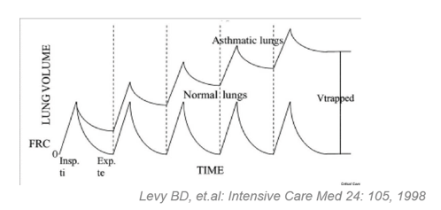
Elevated plateau pressure
Stiff lungs (ARDS, pneumonia, pretty much any infiltrate)
Water-logged lungs (worsening edema)
Over-distending the alveoli
Tidal volume is too big
Ventilating only a single lung (Pneumothorax, main-stem intubation)
External compression (effusion, chest wall, abdomen)
PEEP…
Intrinsic PEEP aka ‘auto-PEEP’, air trapping
Extrinsic PEEP

Slide 17
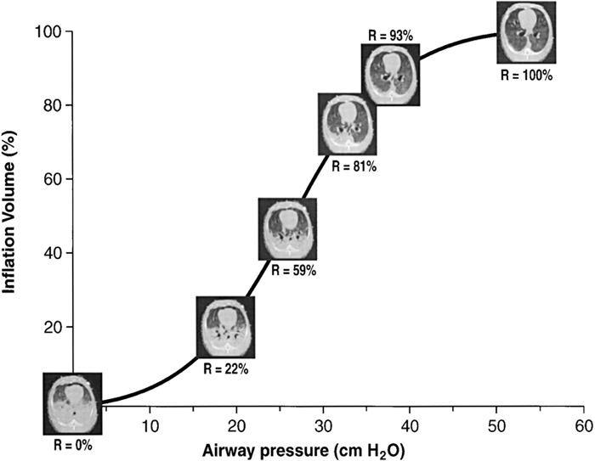
PEEP increased by 4 cmH2O… how much should the plateau go up?
If you recruit lung: by less than 4 cmH2O
If you over-distend alveoli, by less than 4 cmH2O
If both the above don’t change, it’ll go up by 4 cmH2O
Driving Pressure
0 mmHg
Notes:
Plateau pressure = PEEPintrinsic + PEEPextrinsic + Driving Pressure
Driving pressure = the amount of pressure it takes to open the lung to the volume you’re getting.
The only way to know is to try it.

Slide 18
What if peak is high, plateau is low?
Problems with flow
Bronchospasm
Mucus plug
Kink in the ventilator tubing or ETT
Giving breaths with very fast rate
What is the consequence of a high peak pressure if the plateau is low?
NOTHING

Slide 19
Then why are the RN’s always coming to me with the peak pressure?
Pressure measured here
You can’t accurately measure an accurate end-inspiratory hold if the patient is making inspiratory efforts
If deeply sedated or paralyzed, will be accurate.
Resistive Pressure
P
Distending Pressure
Muscular Effort
Notes:
Often, we follow the peak pressures IF we are confident that the flow resistance hasn’t changed.
If you can make some guesses based on the Flow-Volum loops, but this is advanced.
If you really can’t figure it out, sometimes you need to sedate the patient to get this info

Slide 20
Expiratory hold maneuver
Giving breath too fast
Notes:
Can you get an accurate plateau pressure? If so, do it
If Plat is also high: (static pressure problem)
CXR (PTX, edema, worsening ARDS),
US for pneumothorax/effusion,
titrate the PEEP down if you can
Drop the Vt if you can
If plateau is not high: (flow pressure problem)
Make sure there is no kink in the tubing
Suction out goobers
Give bronchodilators.
Slow the speed the breath is given
If you can’t get a plateau pressure – try some things from both, consider sedation if you really need to know.

Slide 21
In sum,
In ACVC, Tidal Volume and Inspiratory time are set, so pressure will vary based on the patient’s lung physiology
Ventilator pressures (specifically, the plateau pressure) tell you about whether current ventilation is lung protective
Tradeoff between Lung Protection (early) vs Light Sedation (late)
High peak pressure will be the finding nurses and RTs notice
How will this change in ACPC? (answer at end)
Perform a breath hold (if you can) to separate causes of elevated resistance to flow (low plateau) vs high distending pressure (high plateau)

Slide 22
”The patient looks uncomfortable”
“Or, I had to go up on the sedation”
Observation (confounded) data suggests:
25% of all patients have dis-synchrony
50% who are the vent more than a day will.
They do worse. Maybe even worse mortality

Slide 23
Double Triggering -> Breath Stacking
Two breaths are given for the patient making one respiratory effort
This is a problem because it doubles the distention of the lung
Cause: the patient’s brain stem wants a larger/longer inspiration than the vent gives.
Low Tidal Volume = unnatural
Drive to breath = high

Slide 24
Double Triggering -> Breath Stacking
Treatment options:
Increase sedation (often preferrable if early = strict low tidal volume ventilation needed)
Neuromuscular blockade if needed
Increase vent inspiratory time
increase tidal volume (often preferrable if later = lighter sedation prioritized.
Notes:
Two breaths are given for the patient making one respiratory effort
This is a problem because it’s equivalent to 12 ml/Kg of distention in the lung.

Slide 25
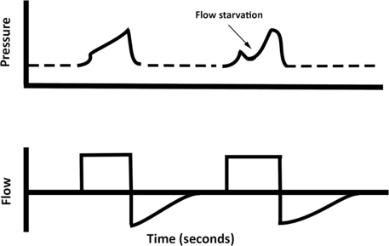
Flow starvation -> wasted effort
Cause
Patient wants more flow than the vent gives (common on ACVC)
Consequence:
Skeletal muscle and diaphragm strain
Lung injury (pleural pressure negative during efforts)

Slide 26
Flow starvation -> wasted effort
Treatment Options:
Increase the flow rate to 50-60, can increase up to 80.
This will cause peak pressure to go up
Switch to ramp waveform
Switch to ACPC

Slide 27
A warmup riddle: answers
ABG is 7.15 / 75 / 50 on FiO2 1.0 an PEEP 14, RR 30, Vt 6 ml/Kg
What will stop you from going up on each of these indefinitely?
Oxygenation = obviously can’t go above pure oxygen.
What would happen if you kept going up on PEEP? When would you stop?
Plateau is likely to increase above 30 cmH2O
What would happen if you kept going fast on RR?
AutoPEEP due to insufficient time to exhale
What would happen if you kept going up on the Vt?
Plateau is likely to increase above 30 cmH2O
What will the RNs/RTs come to you with in ACPC instead of high peak pressure?
“Tidal volume [or Minute Ventilation] is low”. Can still check plat / do all the same troubleshooting

Slide 28
Questions?
brian.locke@hsc.utah.edu

